Slide 1




Slide 2
Today’s session
In today’s session we are going to
Count till 100
Make numbers up to 99.
Read and write the numbers and their number names.

Slide 3
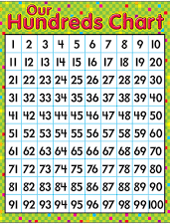
Quick Recap
Numbers 1 to 9 are called 1 digit numbers
Numbers 10 to 99 are called 2 digit numbers
100 is a three digit number

Slide 4

Quiz time
1
The smallest 1 digit number is
The greatest 2 digit number is
The smallest 3 digit number is
The greatest 1 digit number is
The smallest 2 digit number is
99
100
9
10

Slide 5

11
Base 10 System
10 ones = 1 ten

Slide 6
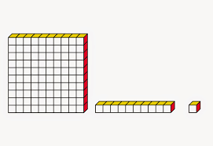
Building numbers
Forty - three
Tens | Ones
4 | 3
Tens | Ones
3 | 2
Three - two
Thirty – two

Slide 7
Numbers and their number names.
55
Fifty - five
90
Ninety

Slide 8
Suggested activity
Using the given handouts write the number names of
38
92
45
69
13
In you math rough note.
Discuss with your parents the importance of numbers.

